Slide 1
Recap lecture 11
Proof of Kleene’s theorem part II (method with different steps), particular examples of TGs to determine corresponding REs.

Slide 2
Example
Consider the following TG
To have single initial and single final state the above TG can be reduced to the following
b
b
1-
3+
aa
a
a
2-
4+
bb

Slide 3
Example continued …
b
To obtain single transition edge between 1 and 3; 2 and 4, the above can be reduced to the following
b
1
3
Λ
aa
Λ
-
a
Λ
a
+
Λ
2
4
bb

Slide 4
Example continued …
b
To eliminate states 1,2,3 and 4, the above TG can be reduced to the following TG
1
b+aa
3
Λ
Λ
-
a
Λ
+
Λ
2
a+bb
4
Λ(b+aa)b*Λ
-
+
Λ(a+bb)a*Λ

Slide 5
Example continued …
(b+aa)b*
To connect the initial state with the final state by single transition edge, the above TG can be reduced to the following
Hence the required RE is (b+aa)b*+(a+bb)a*
-
+
(a+bb)a*
-
(b+aa)b*+(a+bb)a*
+

Slide 6
Example
Consider the following TG, accepting EVEN-EVEN language
aa,bb
aa,bb
ab,ba
-+1
2
ab,ba

Slide 7
Example continued ...
It is to be noted that since the initial state of this TG is final as well and there is no other final state, so to obtain a TG with single initial and single final state, an additional initial and a final state are introduced as shown in the following TG

Slide 8
Example continued ...
To eliminate state 2, the above TG may be reduced to the following
aa+bb
aa+bb
ab+ba
3-
Λ
1
2
ab+ba
Λ
4+

Slide 9
Example continued ...
aa+bb
To have single loop at state 1, the above TG may be reduced to the following
3-
Λ
1
(ab+ba)(aa+bb)*(ab+ba)
Λ
4+

Slide 10
Example continued ...
To eliminate state 1, the above TG may be reduced to the following
(aa+bb)+(ab+ba)(aa+bb)*(ab+ba)
3-
Λ
1
Λ
4+

Slide 11
Example continued ...
Hence the required RE is (aa+bb+(ab+ba)(aa+bb)*(ab+ba))*
Λ(aa+bb+(ab+ba)(aa+bb)*(ab+ba))*Λ
3-
4+

Slide 12
Kleene’s Theorem Part III
Statement:
If the language can be expressed by a RE then there exists an FA accepting the language.
A) As the regular expression is obtained applying addition, concatenation and closure on the letters of an alphabet and the Null string, so while building the RE, sometimes, the corresponding FA may be built easily, as shown in the following examples

Slide 13
Example
Consider the language, defined over Σ={a,b}, consisting of only b, then this language may be accepted by the following FA
which shows that this FA helps in building an FA accepting only one letter
a,b
1
a
-
b
+
a, b

Slide 14
Example
Consider the language, defined over Σ={a,b}, consisting of only , then this language may be accepted by the following FA
a, b
a, b
±

Slide 15
Kleene’s Theorem Part III Continued …
As, if r₁ and r₂ are regular expressions then their sum, concatenation and closure are also regular expressions, so an FA can be built for any regular expression if the methods can be developed for building the FAs corresponding to the sum, concatenation and closure of the regular expressions along with their FAs. These three methods are explained in the following discussions

Slide 16
Kleene’s Theorem Part III Continued …
Method1 (Union of two FAs): Using the FAs corresponding to r₁ and r₂ an FA can be built, corresponding to r₁+ r₂. This method can be developed considering the following examples

Slide 17
Example
Let r₁=(a+b)*b defines L₁ and the FA₁ be
and r₂ = (a+b )*aa(a+b )* defines L₂ and FA₂ be
a
b
b
X₁–
X₂+
a
b
a,b
a
y₁-
y₂
a
y₃+
b

Slide 18
Sum of two FAs Continued …
Let FA₃ be an FA corresponding to r₁+ r₂, then the initial state of FA₃ must correspond to the initial state of FA₁ or the initial state of FA₂.
Since the language corresponding to r₁+ r₂ is the union of corresponding languages L₁ and L₂, consists of the strings belonging to L₁or L₂ or both, therefore a final state of FA₃ must correspond to a final state of FA₁ or FA₂ or both.

Slide 19
Sum of two FAs Continued …
Since, in general, FA₃ will be different from both FA₁ and FA₂, so the labels of the states of FA₃ may be supposed to be z₁,z₂, z₃, …, where z₁ is supposed to be the initial state. Since z₁ corresponds to the states x₁ or y₁, so there will be two transitions separately for each letter read at z₁. It will give two possibilities of states either z₁ or different from z₁. This process may be expressed in the following transition table for all possible states of FA_{3.}

Slide 20
Example continued …
a
b
b
X₁–
X₂+
b
a
a,b
a
y₁–
y₂
a
y₃+
b
Old states | New states after reading
 | a | b
z₁–(x₁,y₁) | (x₁,y₂) z₂ | (x₂,y₁)  z₃

Slide 21
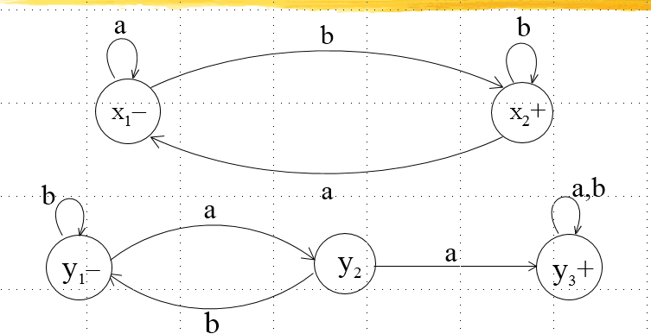
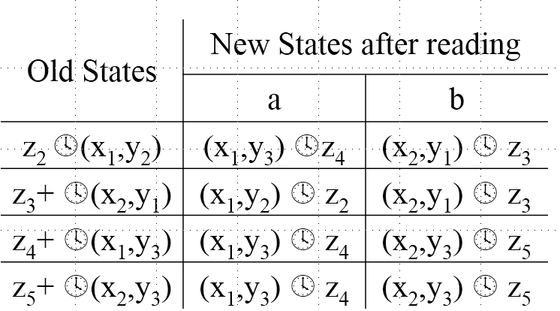

Slide 22
Example continued …
Old States | New States after reading
 | a | b
z₂ (x₁,y₂) | (x₁,y₃) z₄ | (x₂,y₁)  z₃
z₃+ (x₂,y₁) | (x₁,y₂)  z₂ | (x₂,y₁)  z₃
z₄+ (x₁,y₃) | (x₁,y₃)  z₄ | (x₂,y₃)  z₅
z₅+ (x₂,y₃) | (x₁,y₃)  z₄ | (x₂,y₃)  z₅

Slide 23
Example continued …
RE corresponding to the above FA may be r₁+r₂ = (a+b)*b + (a+b )*aa(a+b )*
Z₂
a
a
b
a
b
Z₁-
a
b
Z₄ +
Z₅ +
b
a
Z₃+
b

Slide 24
Summing Up
Examples of writing REs to the corresponding TGs, RE corresponding to TG accepting EVEN-EVEN language, Kleene’s theorem part III (method 1:union of FAs), examples of FAs corresponding to simple REs, example of Kleene’s theorem part III (method 1) continued

